Slide 1

P
SC
^
An Analysis of student-submitted professor ratings

Slide 2
Choosing Your Educational Future

Slide 3
Choosing Your Educational Future

Slide 4
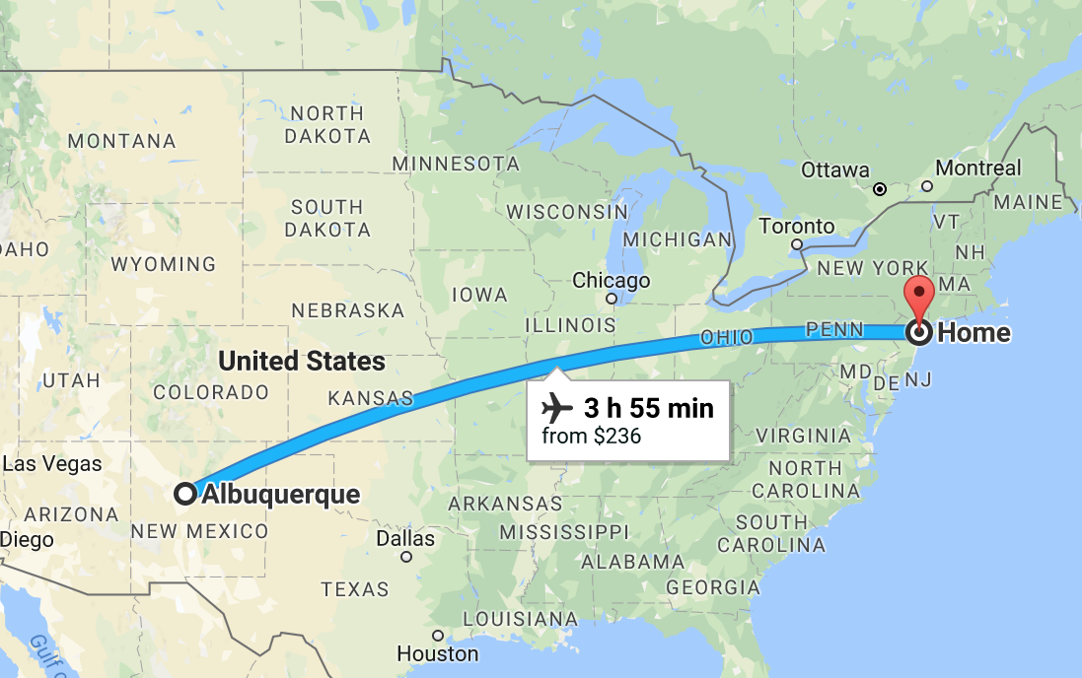
Choosing Your Educational Future

Slide 5
Choosing Your Educational Future

Slide 6
Choosing Your Educational Future

Slide 7

Choosing Your Educational Future

Slide 8
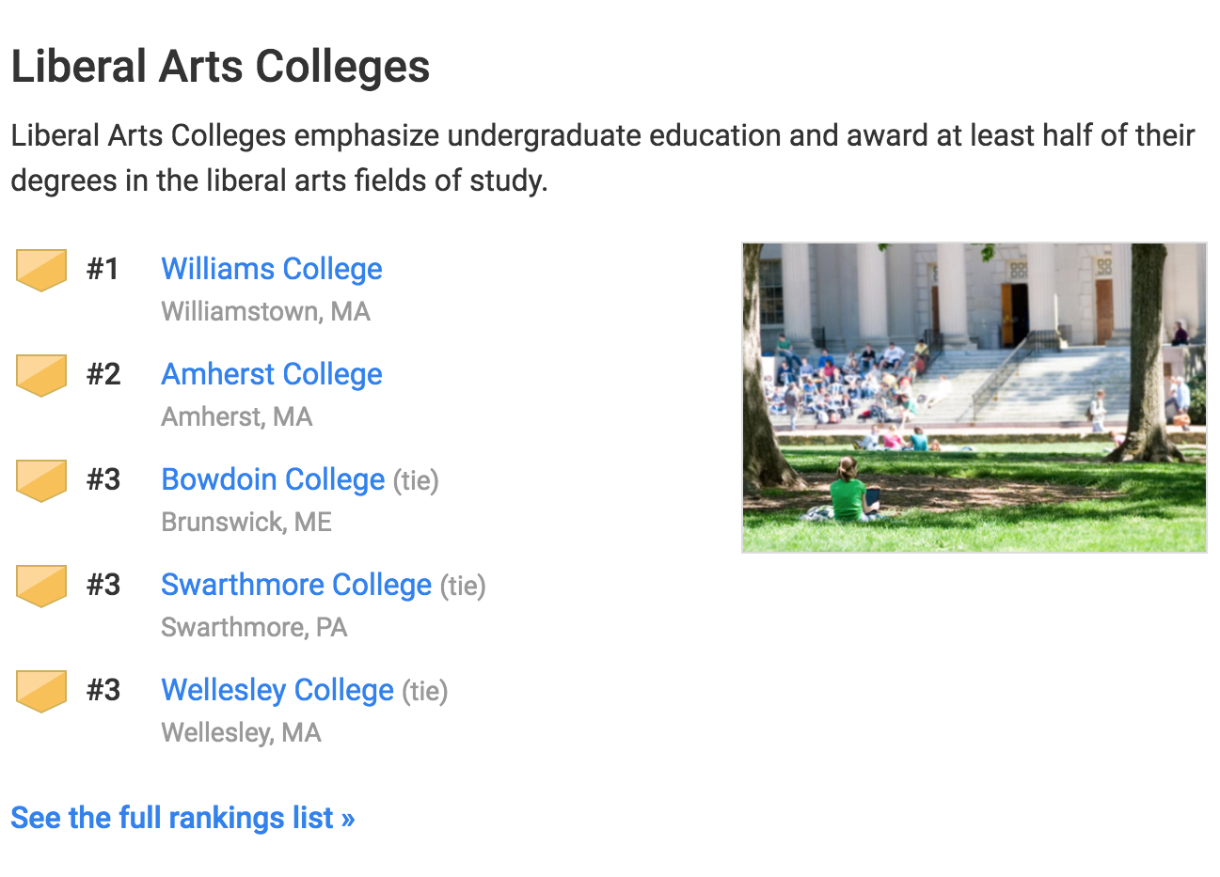
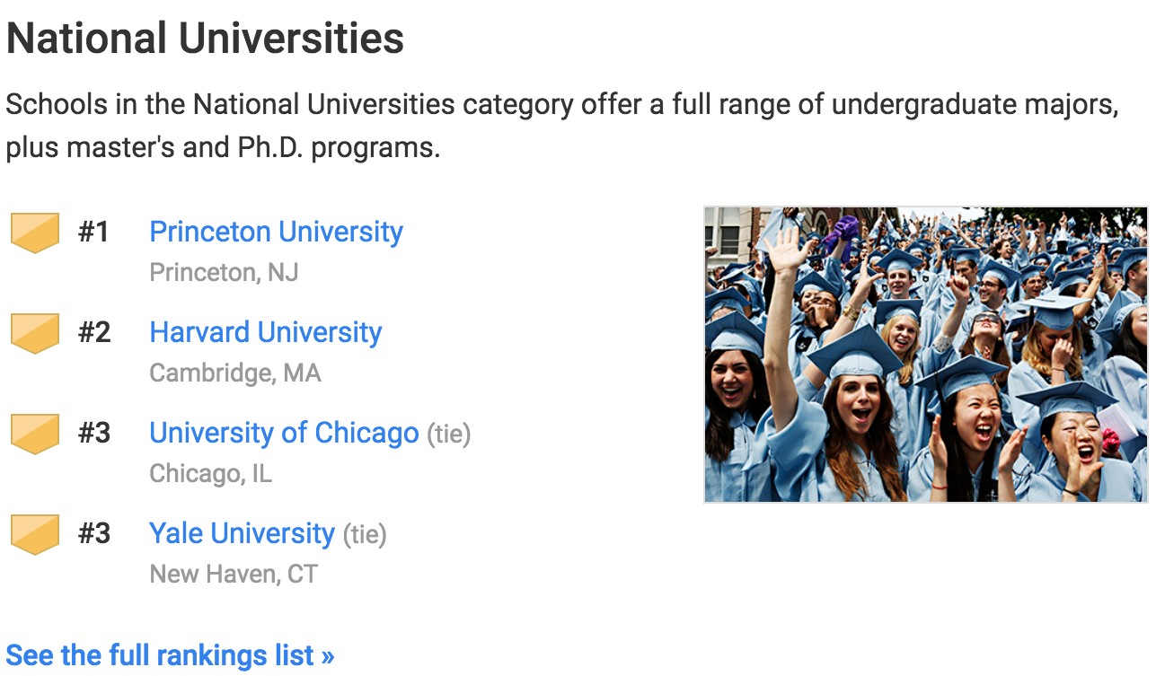
Choosing Your Educational Future

Slide 9
Choosing Your Educational Future
Graduation Rate
Undergraduate reputation (opinion-based)
Faculty Resources (class size)
School selectivity (test scores, rejection rate)

Slide 10
Choosing Your Educational Future
Graduation Rate
Undergraduate reputation (opinion-based)
Faculty Resources (class size)
School selectivity (test scores, rejection rate)
> 4500 institutions of higher learning in US
> 300 in NY State

Slide 11

RateMyProfessors.com

Slide 12
RateMyProfessors.com
Founded in 1999 as TeacherRatings.com
Originally rating only instructors

Slide 13
RateMyProfessors.com
Founded in 1999 as TeacherRatings.com
Originally rating only instructors
Sold to Viacom’s mtvU in 2007

Slide 14
RateMyProfessors.com
Founded in 1999 as TeacherRatings.com
Originally rating only instructors
Sold to Viacom’s mtvU in 2007
Professors and campuses
8000+ schools
1.4+ million professors listed
15+ million ratings

Slide 15
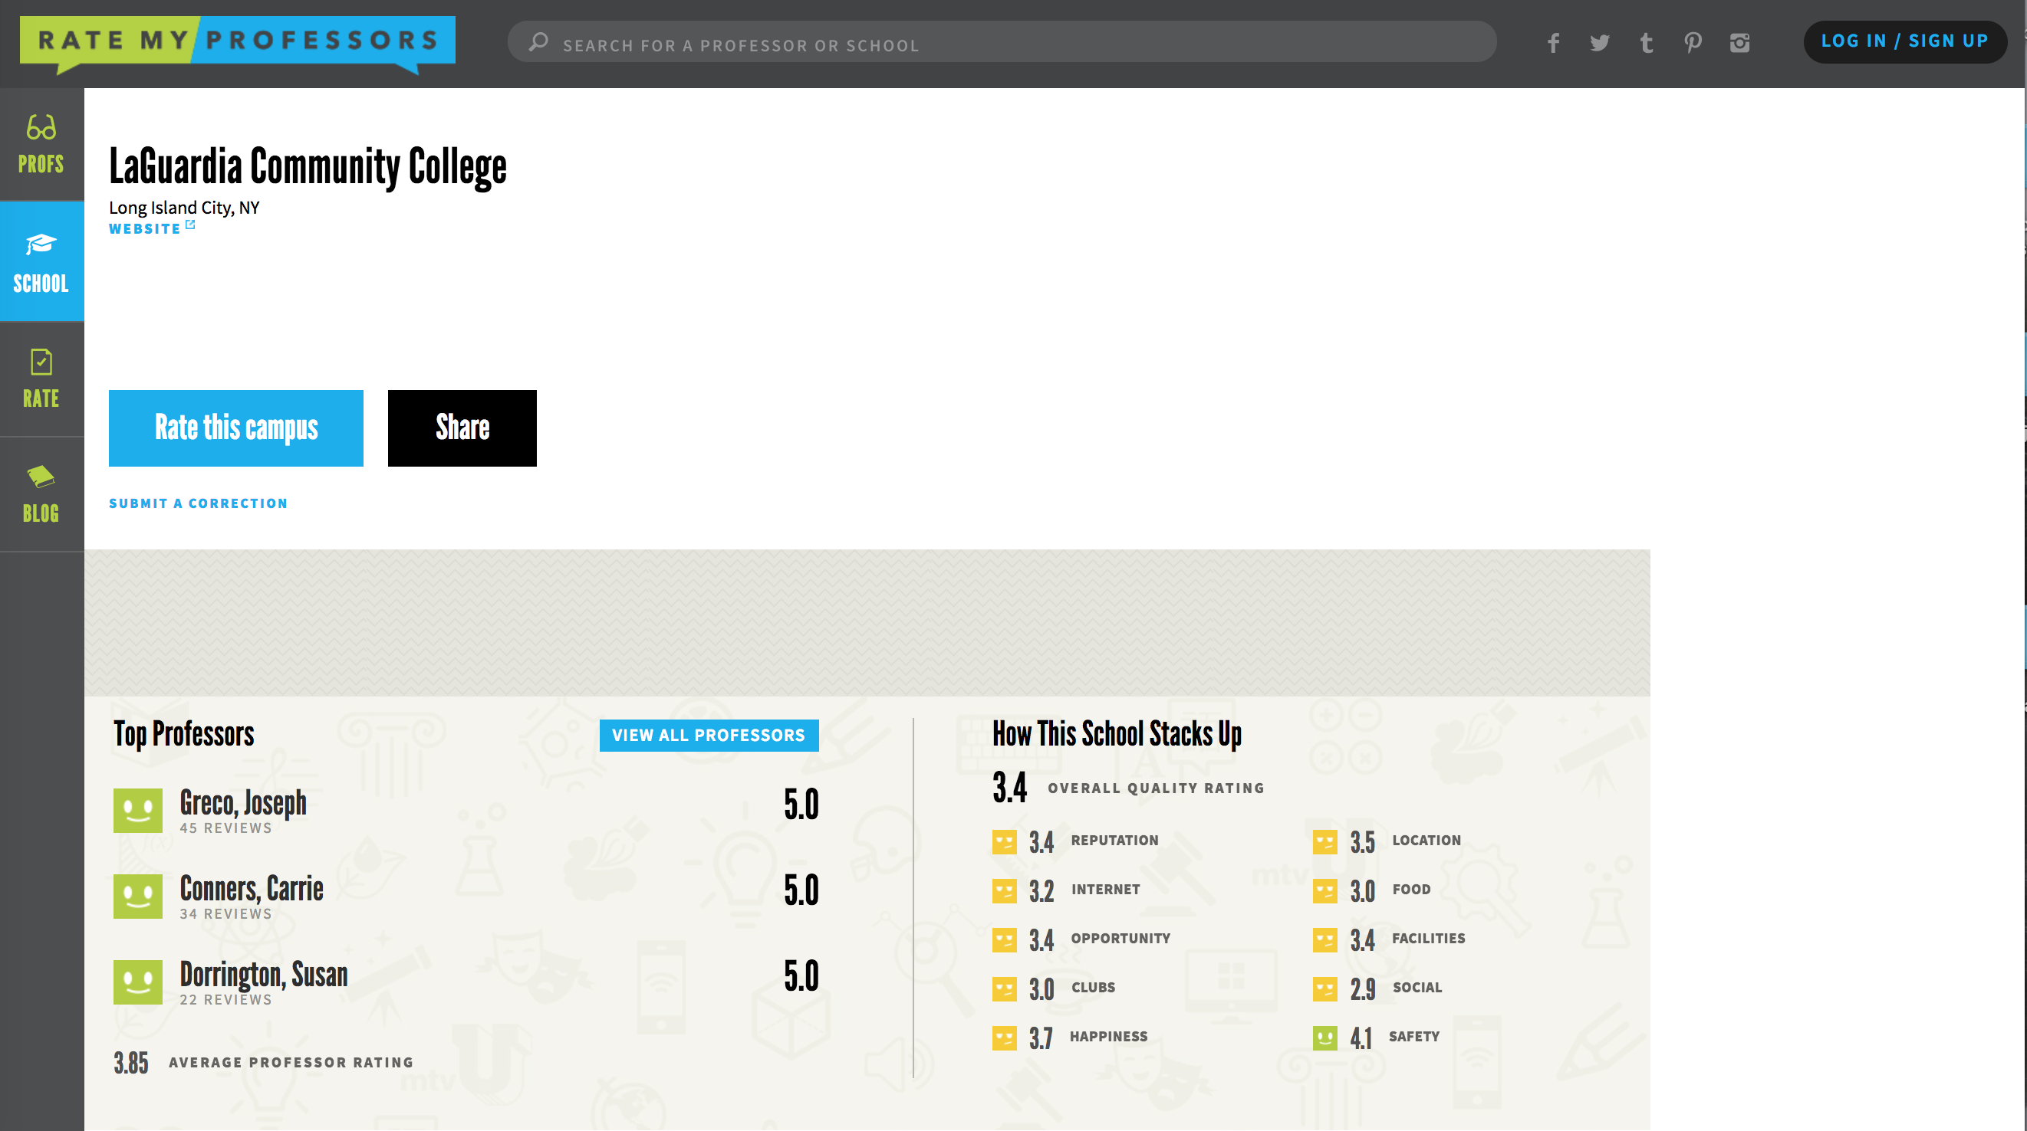
RateMyProfessors.com

Slide 16
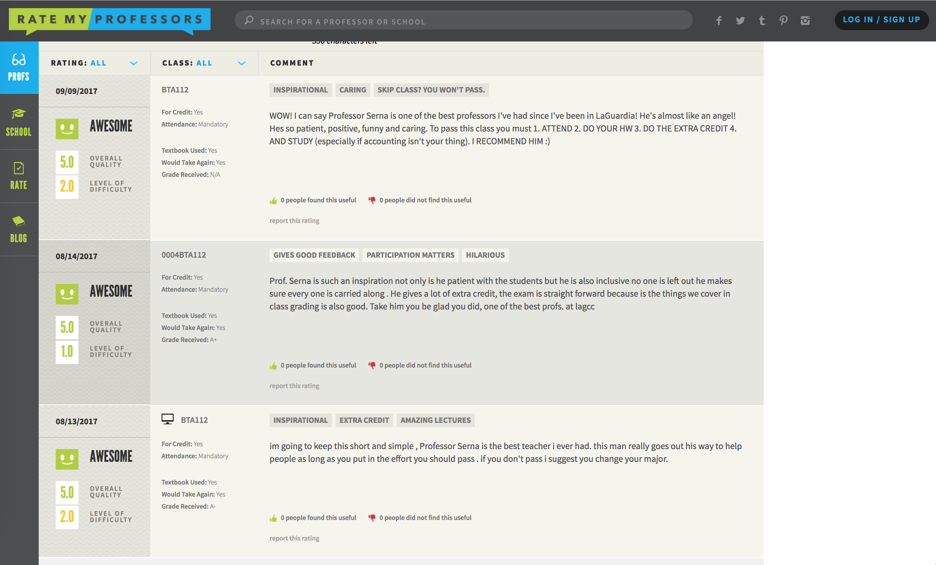
RateMyProfessors.com

Slide 17
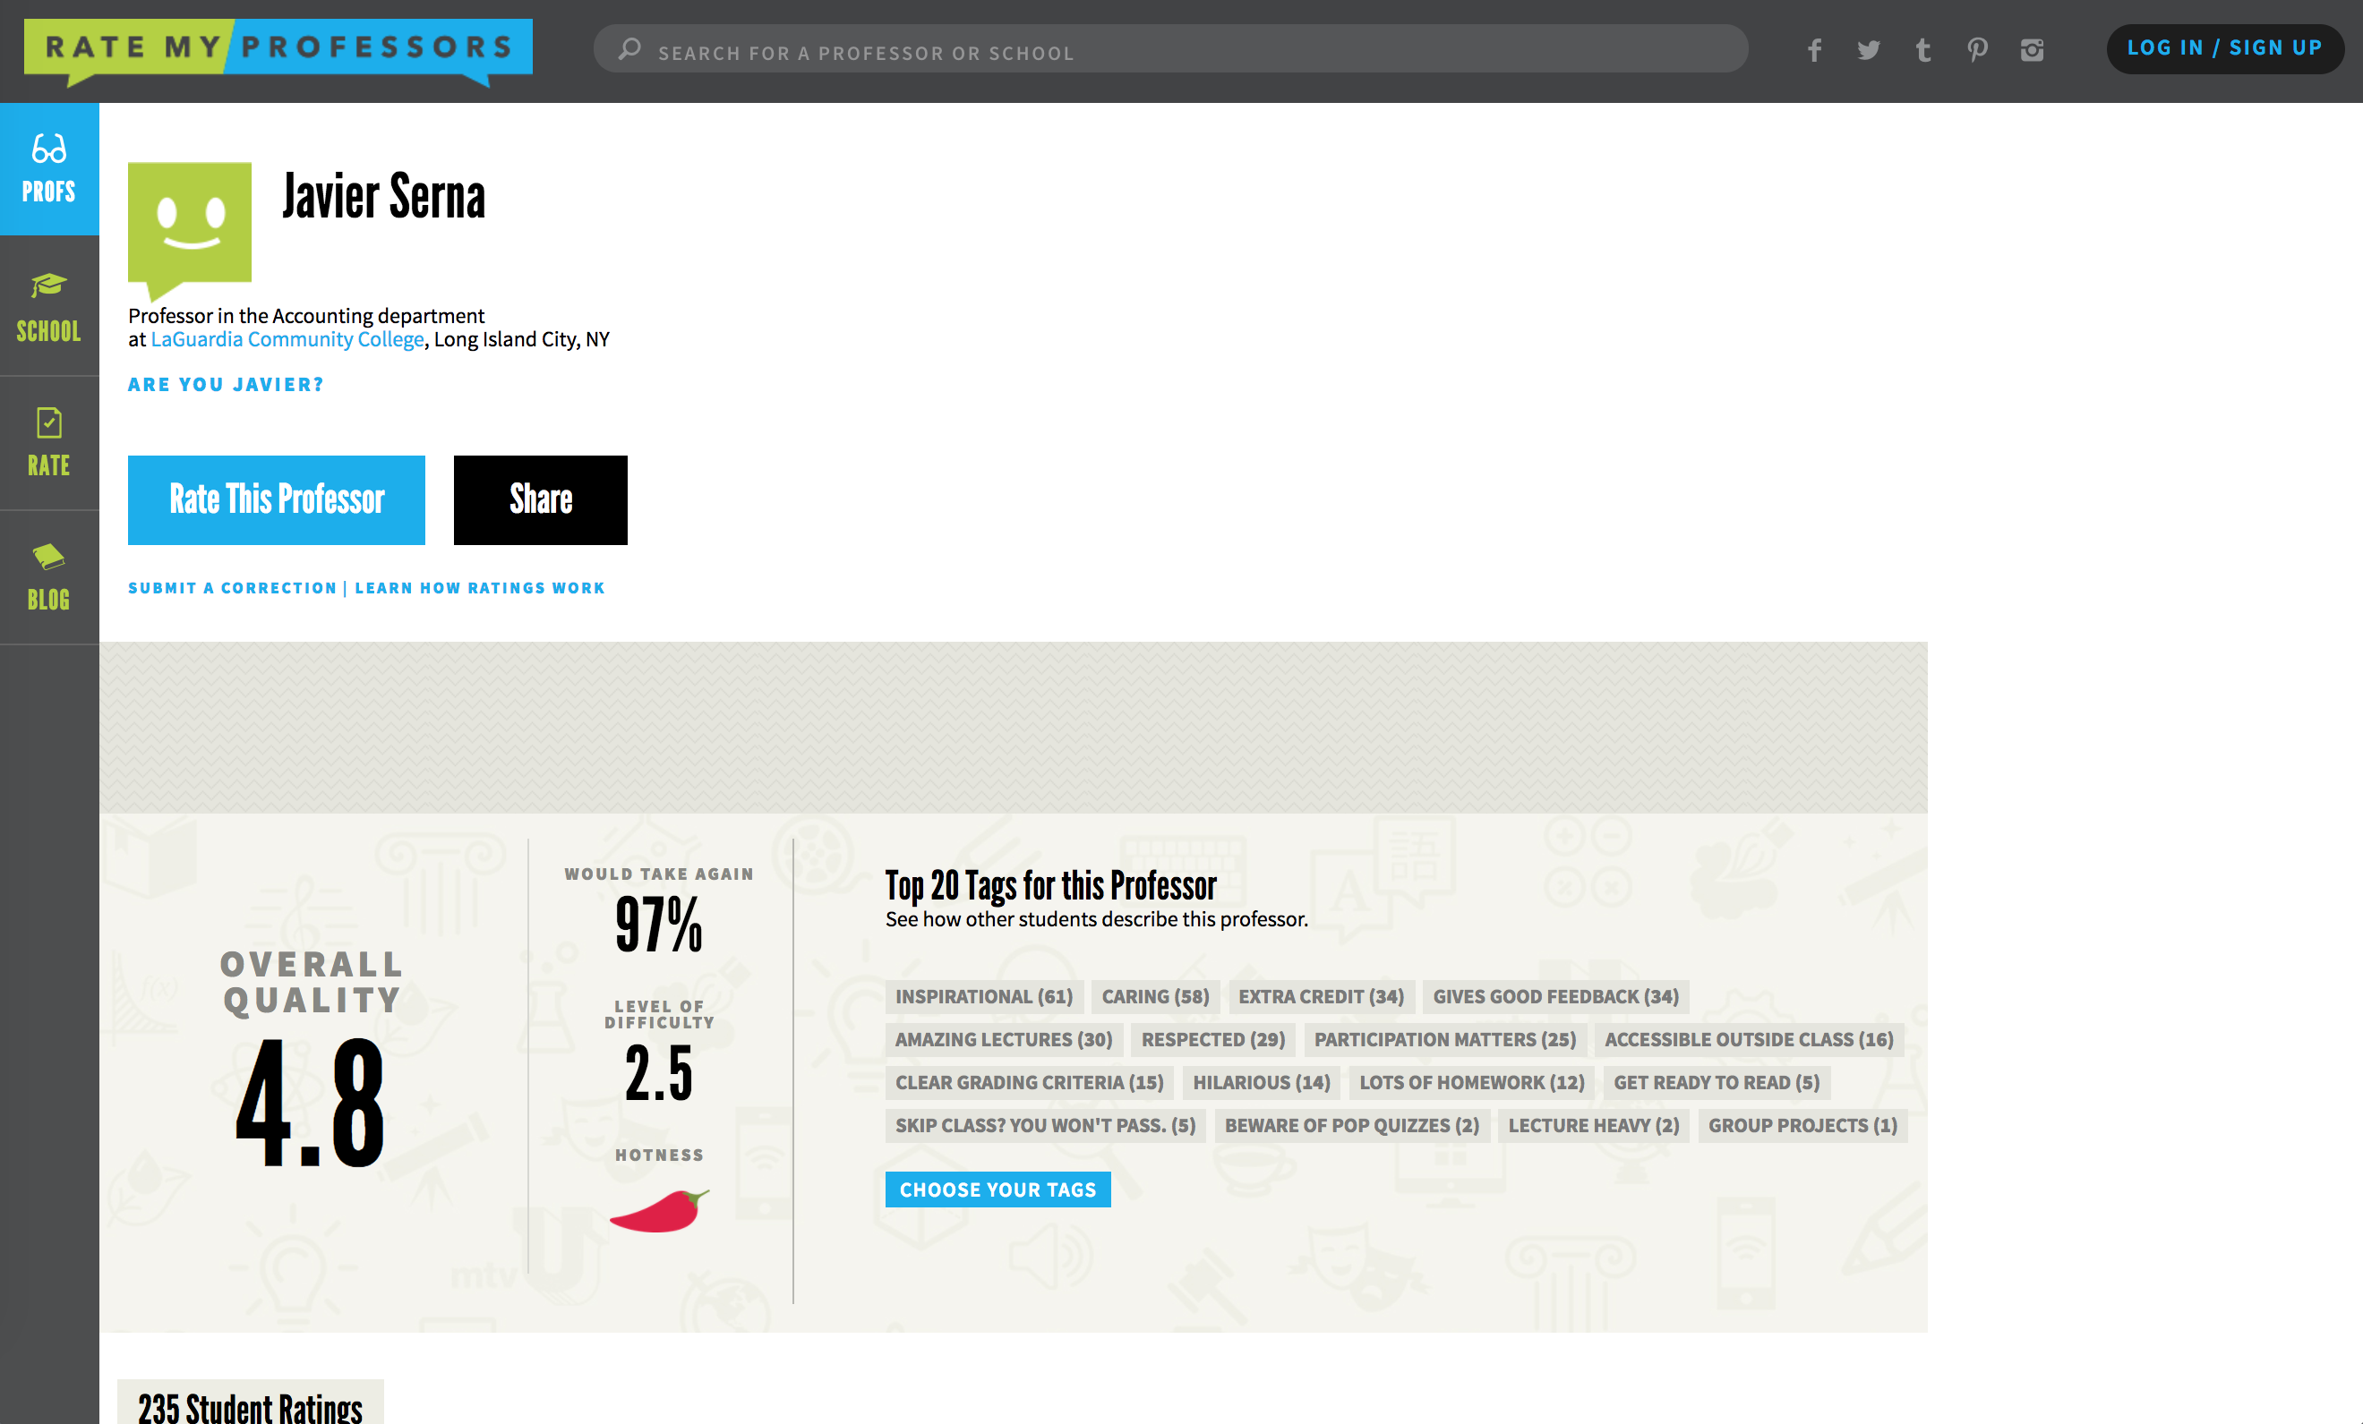
Scraping RateMyProfessors.com

Slide 18
Scraping RateMyProfessors.com

Slide 19
Scraping RateMyProfessors.com

Slide 20
Scraping RateMyProfessors.com

Slide 21
Scraping RateMyProfessors.com

Slide 22
Scraping RateMyProfessors.com

Slide 23
ScrapeMyProfessors.io
Items scraped
Department
Overall/difficulty ratings
Tags
Chili pepper
Comments
Professor sex (from comments)

Slide 24
ScrapeMyProfessors.io
Items scraped
Department
Overall/difficulty ratings
Tags
Chili pepper
Comments
Professor sex (from comments)
Campuses
Bor. Manhattan CC 24K
Nassau CC 23K
LaGuardia CC 19.5K
Kingsboro CC 18.5K
Queensboro CC 16K
Enrollment

Slide 25
ScrapeMyProfessors.io
Items scraped
Department
Overall/difficulty ratings
Tags
Chili pepper
Comments
Professor sex (from comments)
Campuses
Bor. Manhattan CC 24K
Nassau CC 23K
LaGuardia CC 19.5K
Kingsboro CC 18.5K
Queensboro CC 16K
Enrollment
Total
Professors: 633
Ratings: 50K

Slide 26
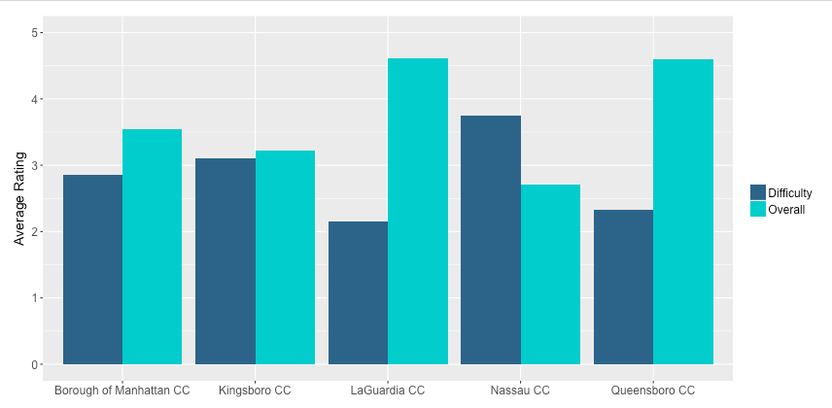
Results
Accounting Department

Slide 27
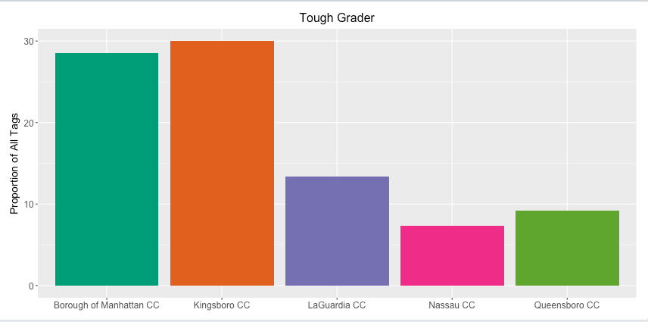
Results
Chemistry Department

Slide 28
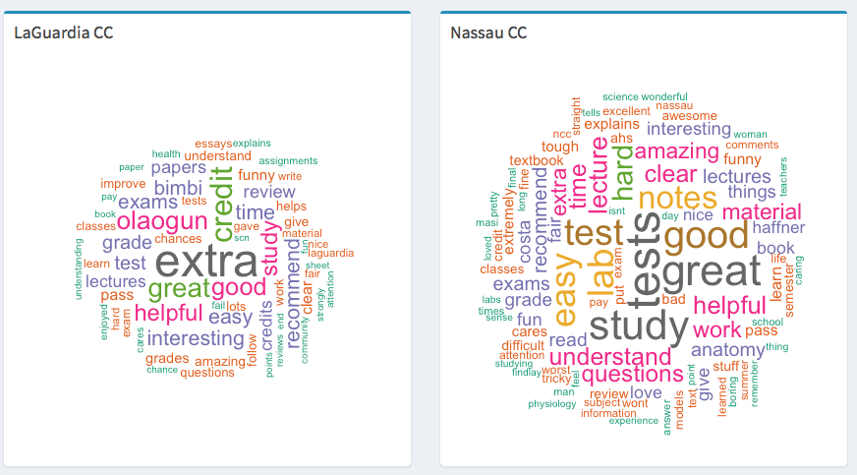
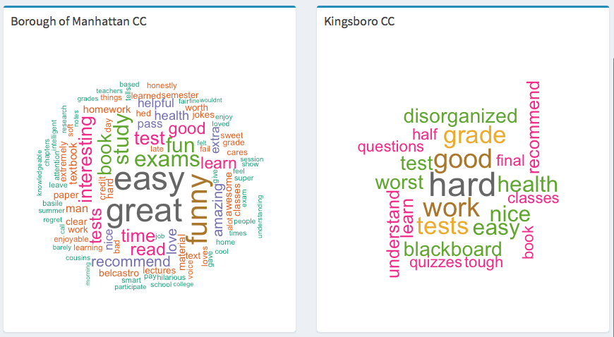
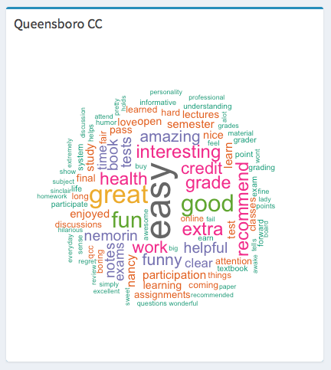
Health
Science
Department

Slide 29
Future Directions
More Schools, Professors
Connect to School Ratings
Compare to Cost of Attendance
Correlate with in-house University Ratings

Slide 30

Ratemyprofessor.com
Originally created to help students already enrolled to take (or avoid)
Certain faculty for classes
It has now grown to giving school ratings as well
You can compare schools based on x, y, z, but what isn’t available
Is info broken down by department
School may be great, but department might be bad
How do you know?

Slide 31
Choosing Your Educational Future
Choosing a place to go to college is a difficult task
It’s heavy and difficult
Large investment, dictates direction of life
So you want to make sure you choose correctly
What tools can you use?
Google top ___ program, but it is difficult to get in
may not be able to afford it or travel that far
There are more than 4500, and 304 in NY State,
2-year and 4-year institutions of higher
Learning in the US
How can you compare certain colleges?

